Slide 1
ECG Signal Classification Using a Hybrid CNN–RNN Model
Presented By :
Sanket Khadake
Kshitij Nanaware
Kayyum Mongal
Shrvan Pandkar

Slide 2
Introduction
Electrocardiogram (ECG) is a non-invasive technique used to record the electrical activity of the heart.
ECG signals contain important information about heart rhythm and cardiac abnormalities.
Manual interpretation of ECG recordings can be time-consuming and requires specialized medical expertise.
Deep learning techniques can automatically extract meaningful features from ECG signals and assist in identifying abnormal patterns.
Convolutional Neural Networks (CNNs) extract important waveform features, while Recurrent Neural Networks (RNNs) learn temporal relationships in the signals.
This project uses a hybrid CNN–RNN model to classify multiple cardiac diagnosis classes using ECG recordings from the PhysioNet/CinC Challenge 2020 dataset.
The model's performance is evaluated using accuracy, precision, recall, F1-score, and ROC-AUC.

Slide 3
Objective
To develop an automated ECG signal classification system using a hybrid CNN–RNN deep-learning model.
To preprocess 12-lead ECG signals by filtering noise, normalizing amplitudes, and standardizing signal length.
To extract important morphological features from ECG signals using Convolutional Neural Networks (CNN).
To learn temporal relationships in ECG waveforms using Recurrent Neural Networks (RNN/BiLSTM).
To classify ECG recordings into 10 cardiac rhythm and abnormality categories using a multi-label classification approach.
To evaluate model performance using accuracy, precision, recall, F1-score, and ROC-AUC.
To analyze the model’s ability to identify different cardiac abnormalities and determine areas for improvement.

Slide 4
Literature Review
1. Perez-Alday et al. (2020) — PhysioNet/CinC Challenge 2020
Presented a multi-institutional dataset and benchmark for automated classification of 12-lead ECGs.
Highlighted the challenges of detecting multiple cardiac abnormalities and generalizing across different data sources. [1]
2. Wagner et al. (2020) — PTB-XL Dataset
Introduced PTB-XL, a large publicly available dataset of 12-lead ECG recordings.
Supports the development and evaluation of machine-learning methods for ECG classification. [2]
3. Hochreiter and Schmidhuber (1997) — Long Short-Term Memory (LSTM)
Introduced LSTM networks to learn long-term dependencies in sequential data.
Provides a foundation for modelling temporal relationships in ECG signals. [3]
4. Meta-analysis of PhysioNet/CinC 2020 methods (2022)
Reviewed approaches used by 41 teams in the ECG classification challenge.
Reported that combining different neural-network architectures can be beneficial, supporting investigation of hybrid deep-learning models. [4]

Slide 5
Methodology
1. Dataset Collection
Dataset source: PhysioNet/CinC Challenge 2020 dataset package.
The notebook uses the PTB-XL directory from the downloaded dataset.
Each ECG contains 12 leads and diagnostic labels.
The .hea file contains metadata and diagnosis codes, while the .mat file contains waveform data.
2. Signal Cleaning
Handle missing or invalid signal values.
Convert recordings to a consistent sampling frequency of 200 Hz.
Apply a third-order Butterworth band-pass filter between 0.5 Hz and 40 Hz.
Use forward–backward filtering to avoid introducing a phase shift.
3. Normalization and Standardization
Normalize each ECG lead using mean and standard-deviation scaling.
Crop or zero-pad each recording to 10 seconds.
Final input shape: 12 leads × 2,000 samples.

Slide 6
Hybrid CNN RNN Architecture
Introduction: A Hybrid CNN–RNN architecture combines Convolutional Neural Networks (CNN) and Recurrent Neural Networks (RNN) to classify ECG signals automatically.
Input ECG Signal: The model receives a preprocessed 12-lead ECG signal containing 2,000 samples per lead, representing 10 seconds of cardiac activity.
Multi-Kernel CNN: The CNN uses one-dimensional convolution layers with kernel sizes of 5, 15, and 25 to extract ECG waveform features at different temporal scales.
Residual Blocks: Residual connections help information and gradients pass through deeper network layers, supporting effective feature learning.
Squeeze-and-Excitation (SE) Attention: SE blocks learn the importance of different feature channels and give greater weight to informative features.
Bidirectional LSTM (BiLSTM): The BiLSTM processes extracted features in forward and backward directions to learn temporal relationships within the ECG signal.

Slide 7
Hybrid CNN RNN Architecture
Feature Classification: The learned features are passed to fully connected layers, which generate predictions for the selected ECG diagnosis categories.
Sigmoid Output Layer: The model uses 10 independent sigmoid outputs because an ECG record may contain multiple diagnoses simultaneously.
Training: The model is trained using weighted binary cross-entropy loss and the AdamW optimizer. Validation performance is used to select the best model.
Advantages: The hybrid architecture combines local waveform feature extraction, temporal learning, and attention-based feature refinement, making it suitable for multi-label ECG classification.

Slide 8
Model Training and Optimization
Data splitting: 70% training, 15% validation, and 15% testing.
Loss function: Binary Cross-Entropy with Logits, using positive-class weighting to address class imbalance.
Optimizer: AdamW with an initial learning rate of 0.001 and weight decay of 0.0001.
Batch size: 256; maximum 40 epochs in the reported configuration.
Model selection: Select the best model using validation macro ROC-AUC.
Learning-rate adjustment: Reduce the learning rate when validation performance stops improving.
Early stopping: Stop training when validation performance does not improve for the configured patience period.
Threshold selection: Determine class-specific decision thresholds from validation predictions before evaluating the test set.

Slide 9
Model Evaluation
Evaluate the selected model on the held-out test dataset.
Generate independent predictions for the ten selected diagnosis categories.
Apply validation-derived thresholds to convert probabilities into binary predictions.
Calculate the following metrics:
  Accuracy: Overall correctness for each diagnosis.
  Precision: Proportion of predicted positives that are correct.
  Recall: Proportion of actual positives detected.
  F1-score: Balance between precision and recall.
  ROC-AUC: Ability to distinguish positive and negative examples across thresholds.
Compare performance across diagnosis categories to identify strong predictions and classes requiring improvement.
Analyze the effect of class imbalance and threshold selection on classification performance.

Slide 10
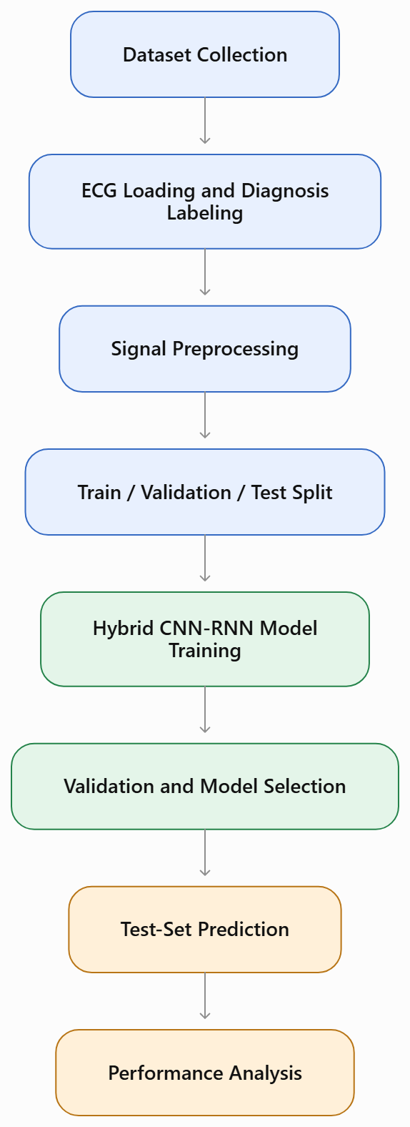
Project Flow :

Slide 11
Result and Performance Analysis
Dataset processed: 21,254 ECG records
Input signal: 12-lead ECG, 10 seconds
Classification: 10 cardiac diagnosis labels
Test Macro ROC-AUC: 0.9430
Test Macro F1-score: 0.7384
Mean per-class accuracy: 0.9211
Key Observations
The model achieved strong overall discrimination, with a macro ROC-AUC of 94.30%.
Sinus rhythm achieved the highest F1-score of 0.960.
Atrial fibrillation achieved an F1-score of 0.850.
Ventricular ectopics achieved an F1-score of 0.826.

Slide 12
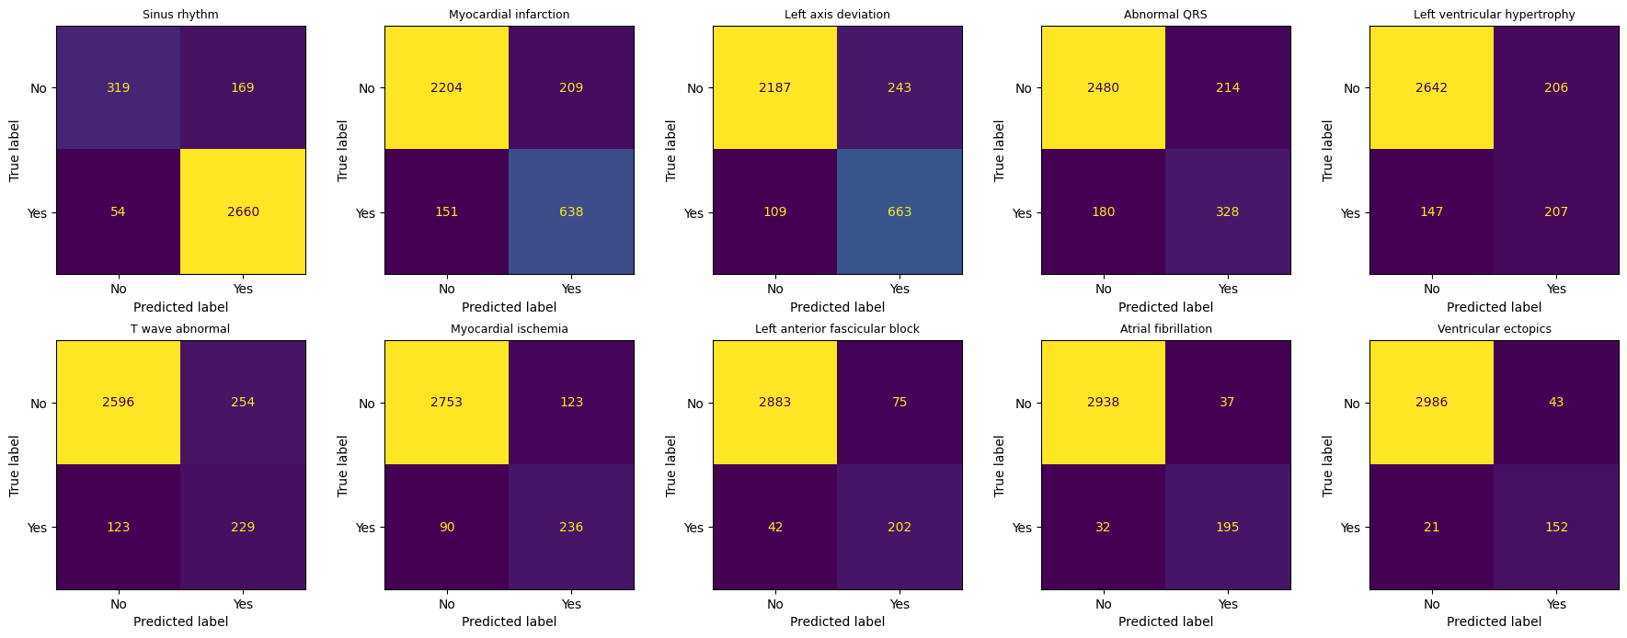
Confusion Matrix

Slide 13
Conclusion
The confusion matrices show the performance of the proposed hybrid CNN–RNN model in classifying ten ECG diagnosis categories. The model performs well for sinus rhythm, atrial fibrillation, and ventricular ectopics. However, left ventricular hypertrophy, T-wave abnormality, and abnormal QRS remain more challenging because of false-positive and false-negative predictions. Overall, the results demonstrate the potential of deep learning for multi-label ECG classification, while further improvement and independent clinical validation are required.

Slide 14
References
E. A. Perez Alday et al., “Classification of 12-lead ECGs: The PhysioNet/Computing in Cardiology Challenge 2020,” Physiological Measurement, vol. 41, no. 12, 2020. [Online]. Available: https://doi.org/10.1088/1361-6579/abc960
P. Wagner et al., “PTB-XL, a large publicly available electrocardiography dataset,” Scientific Data, vol. 7, article 154, 2020. [Online]. Available: https://doi.org/10.1038/s41597-020-0495-6
S. Hochreiter and J. Schmidhuber, “Long Short-Term Memory,” Neural Computation, vol. 9, no. 8, pp. 1735–1780, 1997. [Online]. Available: https://doi.org/10.1162/neco.1997.9.8.1735
A. Y. Hannun et al., “Cardiologist-level arrhythmia detection and classification in ambulatory electrocardiograms using a deep neural network,” Nature Medicine, vol. 25, pp. 65–69, 2019. [Online]. Available: https://doi.org/10.1038/s41591-018-0268-3
PhysioNet, “Classification of 12-lead ECGs: The PhysioNet/Computing in Cardiology Challenge 2020,” 2022. [Online]. Available: https://physionet.org/content/challenge-2020/1.0.2/

